Slide 29
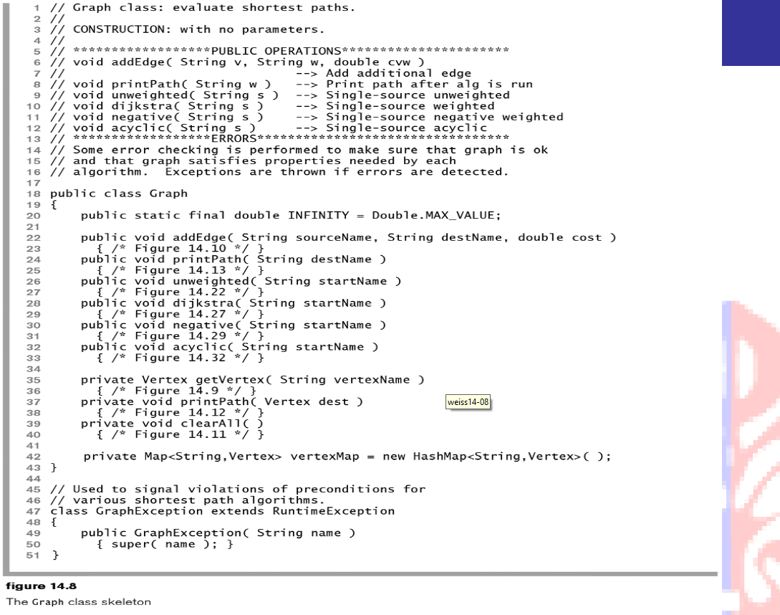

Slide 31
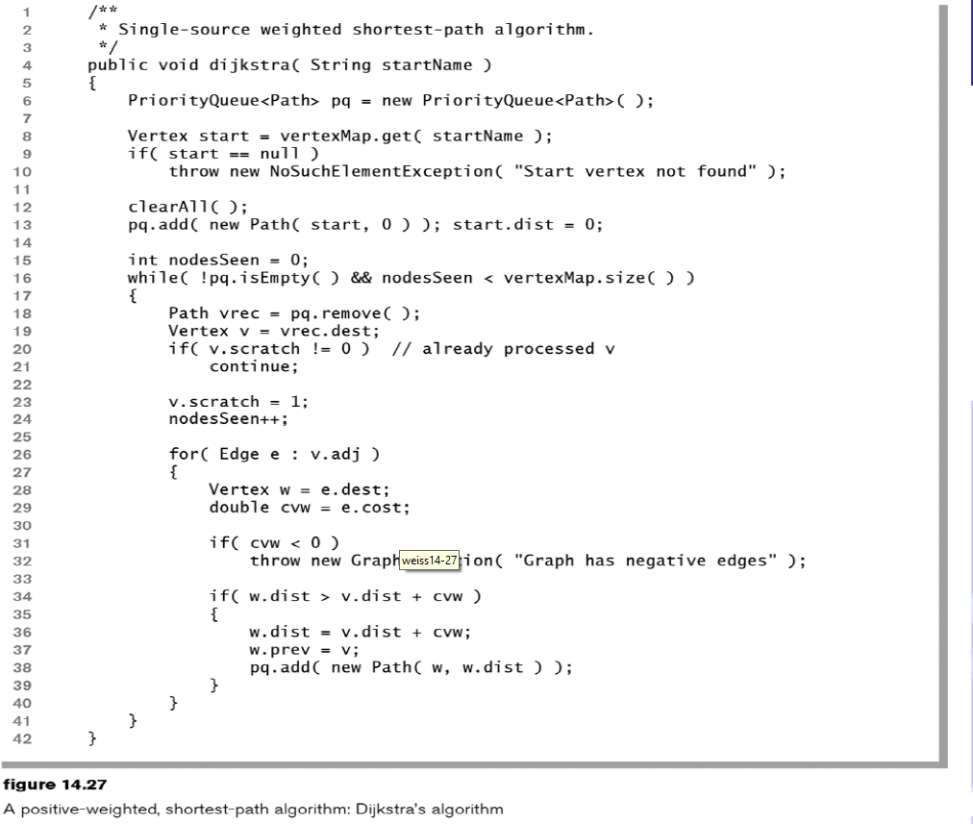

Slide 32
Fakultas Ilmu Komputer • Universitas Indonesia
Slide acknowledgments: Suryana Setiawan, Ade Azurat, Denny, Ruli Manurung, Tisha Melia Tim Dosen: Ruli Manurung, Tisha Melia, Bayu Distiawan, Clara Vania, Zaki Rahman

