Slide 1

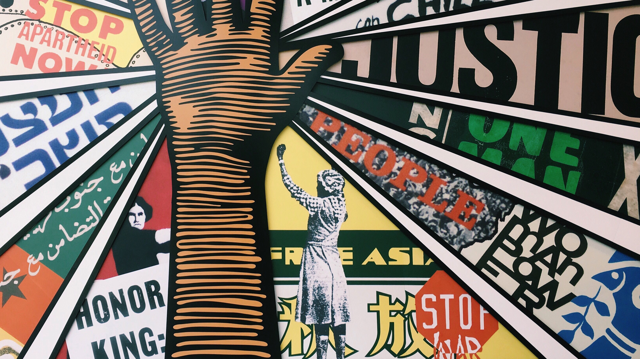
Social movement
Dr sri lestari wahyuningroem
This Photo by Unknown Author is licensed under CC BY-ND

Slide 2

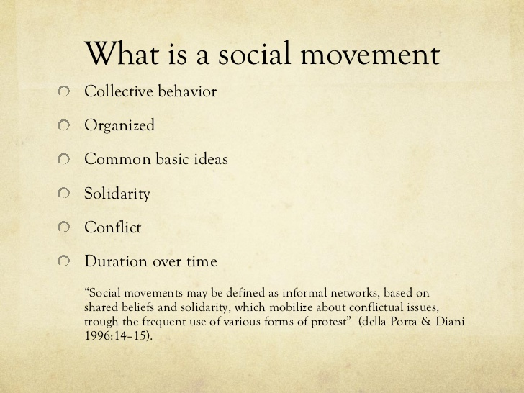

Slide 3
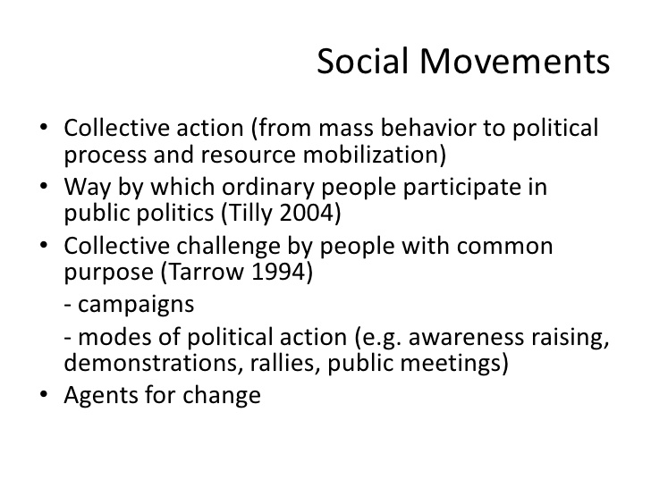

Slide 4
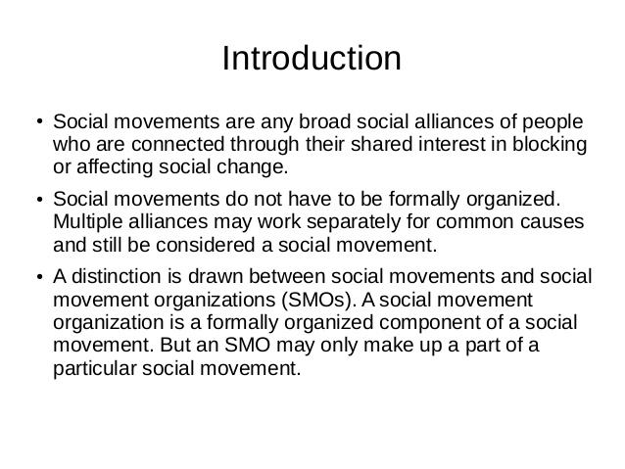

Slide 5
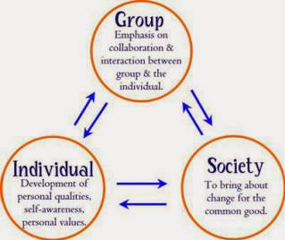
aspects

Slide 6
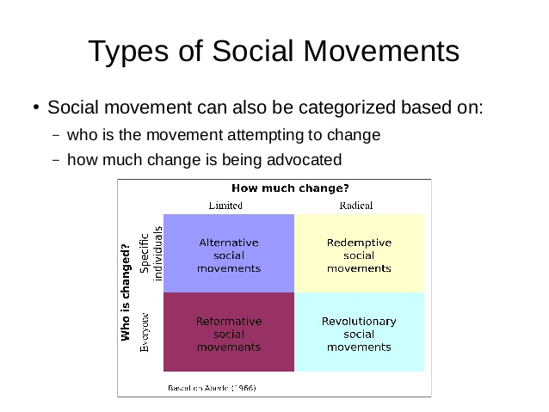

Slide 7
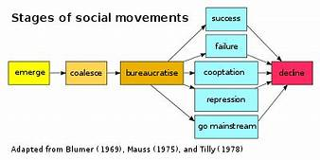

Slide 8
Social Movement
Old social movement
New Social Movement

Slide 9
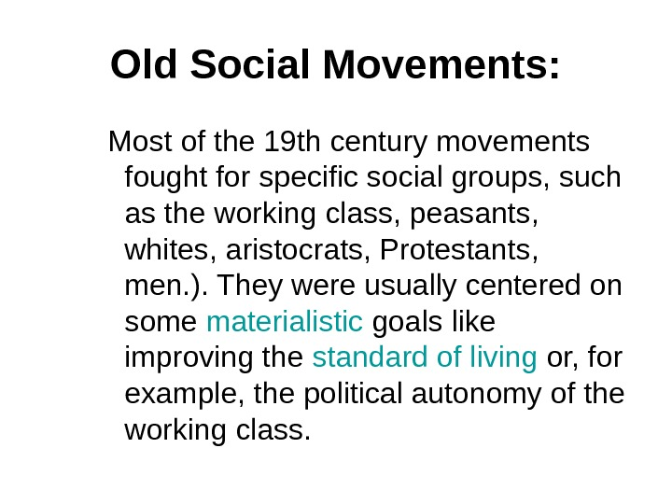

Slide 10
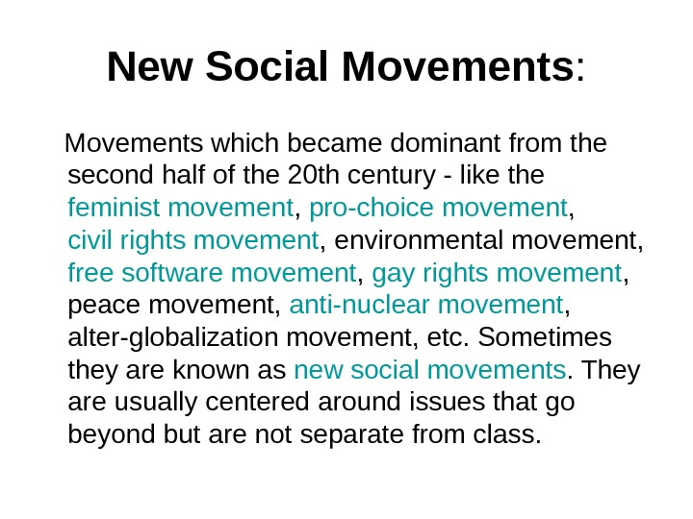

Slide 11
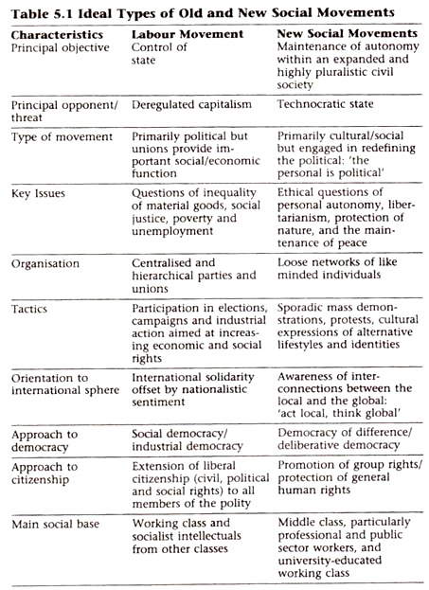

Slide 12
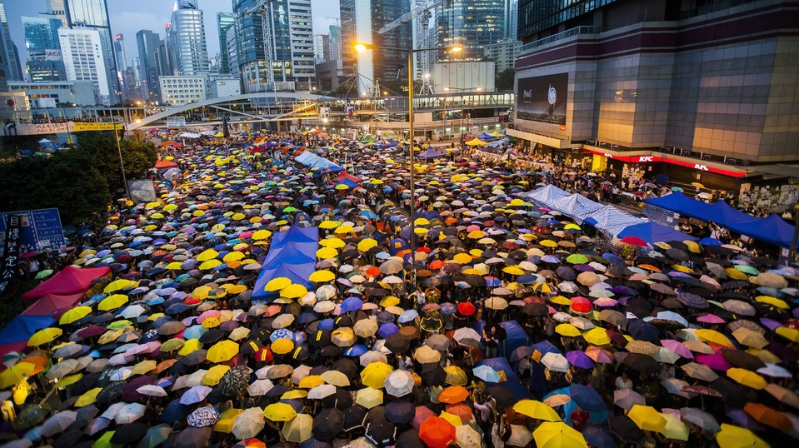
What do we study on social movement?
This Photo by Unknown Author is licensed under CC BY

Slide 13
Four sets of questions (Della Porta and Diani, 1996)
relationship between structural change and transformations in patterns of social conﬂict
the role of cultural representations in social conﬂict
the process through which values, interests, and ideas get turned into collective action
how a certain social, political, and/or cultural context affects social movements’ chances of success, and the forms they take

Slide 14
1. relationship between structural change and transformations in patterns of social conﬂict
Can we see social movements as expressions of conﬂicts? And what conﬂicts?
Have there been changes in the main conﬂicts addressed by social movements? And along what lines?

Slide 15
2. the role of cultural representations in social conﬂict
How are social problems identiﬁed as potential objects of collective action?
How do certain social actors come to develop a sense of commonality and to identify with the same “collective we”?
And how can speciﬁc protest events come to be perceived as part of the same conﬂict? Where do social movement cultures and values originate from?

Slide 16
3. the process through which values, interests, and ideas get turned into collective action
How does it become possible to THE STUDY OF SOCIAL MOVEMENTS to mobilize and face the risks and costs of protest activity?
What are the roles of identities and symbols, emotions, organizations, and networks, in explaining the start and persistence of collective action?
What forms do organizations take in their attempts to maximize the strength of collective challenges and their outcomes?

Slide 17
4. how a certain social, political, and/or cultural context affects social movements’ chances of success, and the forms they take
What does explain the varying intensity over time of collective violence and other types of public challenges against powerholders?
Do the traits of political systems and their attitudes towards citizens’ demands inﬂuence challengers’ impact in the political arena? How do protest tactics and strategies change over time, and why?

Slide 18

Exercise in groups: https://tubitv.com/movies/501455/me_too_the_movement
This Photo by Unknown Author is licensed under CC BY-SA

