Slide 1
Civil Society: Introduction
Dr Sri Lestari wahyuningroem
UPN Veteran Jakarta

Slide 2
“Civil Society”
general terms “an arena of voluntary, uncoerced collective action around shared interests, purposes and values” (Merkel and Lauth 1998, 7).

Slide 3
Timeline of the concept
Pre- 18th century
18th century, Locke, Montesquieu, Hegel
19th century: Marx, de Tocqueville
20th century: Gramsci, Habermas

Slide 4
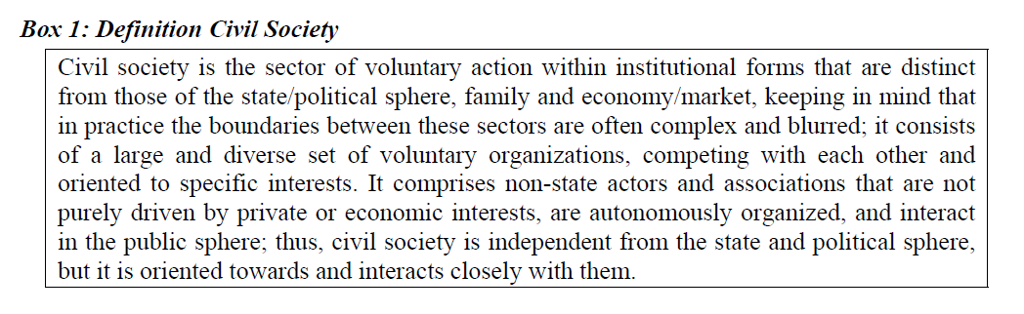
Definition (Spurk, 2008)

Slide 5
Commonness
CS as sector on its own; voluntary, autonomous, interacting in pulic sphere
Both different from the state and the political sphere due to the fact that civil society is making political demands towards the state and others, but not aiming for political offices in government and the state.
Formally and legally independent from the state/political society, but is oriented towards and interacts closely with the state, the political and the economic sector.
differentiated from the market and the business sector (economic sphere) as well as from the family/private realm

Slide 6
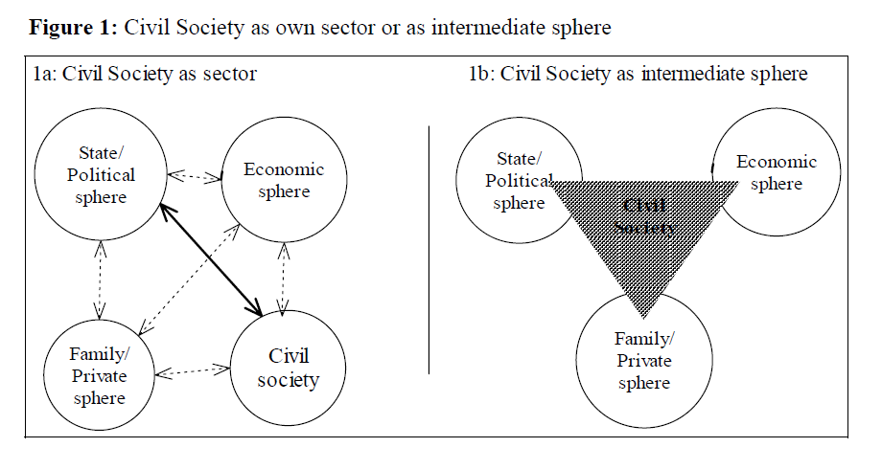
Sector or Intermediate Sphere?

Slide 7
Who are civil society?
1.
2.
3.
dst

Slide 8
CS in Different Contexts
Political transition and democratisation
Western Europe
US and Western Europe
Eastern Europe
CS in the South?

Slide 9
Some imporant topics to be discussed
Global Civil Society
Civils Society in Armed Conflict
Civil Society in Development Cooperation
Uncivil Society
Ambivalent effects of CS

Slide 10
Two research approaches on CS
Actor Oriented
Functional

Slide 11
CS Functions (Merkel and Lauth)
Protection
Intermediation between State and Citizens
Participatory Socialization
Community building and integration
Communication

Slide 12
Edwards’ Roles
CS as associational life
CS as the good society
CS as public sphere

Slide 13
Extending the functions: seven
Protection of citizens
Monitoring for accountability
Advocacy and public communication
Socialization
Building community
Service delivery

Slide 14
Limitations and clarifications of Functional Model
The scope of functions
Uncivil society actors
The role toward the state and within society’
Service delivery as entry point

Slide 15
Source:
Cristoph Spurk, 2008

Slide 16
Discuss the roles and functions
Greenpeace
ICW
AJI
PGRI
FPI
AIPI
PGA

