Slide 1
Civil Society
Dr Sri lestari wahyuningroem

Slide 2
Contents
Etymology
Historically
Modern Times
Natural society
Political society
Civil society
Global society
Today?

Slide 3
Etymology
What is civil society?
NOT DEFINED!

Slide 4
Contestations of frameworks
STATE
group
group
group

Slide 5
Outside of state but has binding structures, rule of law
Politics
Associations
Schools
Organizations

Slide 6
Questions:
Voluntary? Autonomy?
Struggle and contestation? or
Mitigation and maneuvering?
Relations to state?

Slide 7
State
Civil Society
DEMOCRACY

Slide 8
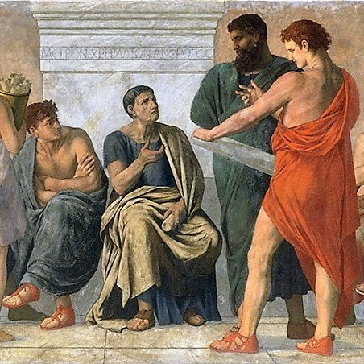
history
Aristoteles: “Zoon Politikon”—the absence of individual rights, and state as community of citizens
Ehrenberg (1999)—civil society in ancient greek:
Civil
Political
Citizens
This Photo by Unknown Author is licensed under CC BY-SA

Slide 9
Also meant
Public (polis)
Private(Households)

Slide 10
Medieval age
Cicero: civil society as Res Republica, laws that guarantee individual rights to property to separate private life from public (politics) life.
The fall of Roman Empire and emergence of feudal society based on small political authorities on political, economic, cultural – civil society?
Church in transcendental matters
Emperors or civil governments

Slide 11
Modern times
Natural Society
Political Society

Slide 12
Natural Society and political society
A society whereby men lived in a state of nature.
No public law. The existing law is law of nature.
Hobbes: homo homoni lupus
Locke: function of state to protect the basic rights of man, otherwise people have the rights to overthrow state.
Basic rights: civil rights.
A society with basic rights: civil society. – the state has to replace natural society to protect civil society.

Slide 13
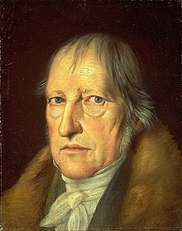
Hegel
Civil society as realm of individuals, private domain, self interest, bonum commune (doesnot concern with prosperity of the whole)
State as totality, prosperity of the whole, the progress of history, Great Spirit that brings prosperity.
State it fulfilled, in itself, the mission of human history.
Individual interest of civil society has to surrender to public interest of the state.
This Photo by Unknown Author is licensed under CC BY-SA

Slide 14
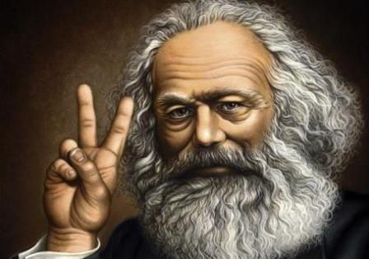
marx
State is not above society, but reflection of society.
Existing structure of civil society (divided between dominant and exploited classes) is reflected in the state.
History and social change do not lie in the state, but in civil society.
Class struggle is the drive force of history of mankind.
This Photo by Unknown Author is licensed under CC BY-SA-NC

Slide 15
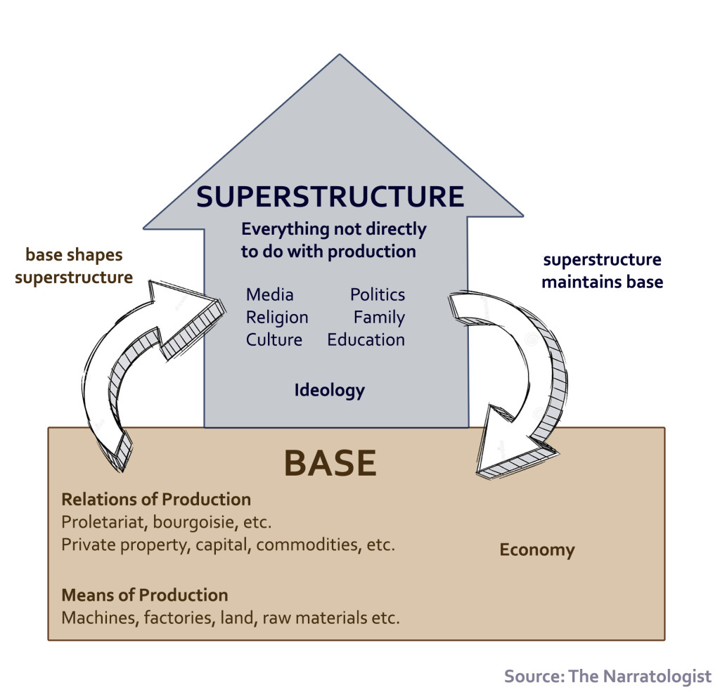

Slide 16
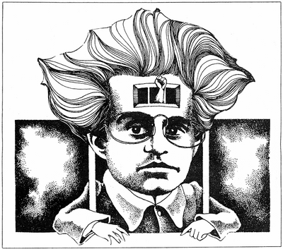
gramsci
Civil society is an aspect of superstructure, together with state.
The base of infrastructure is mode of production, or the dominant economic system of the society.
Two aspects of superstructure: state (aspect of force) and civil society (aspect of culture) with the hegemony of the ruling class.
State and civil society served and strengthened ruling class.
This Photo by Unknown Author is licensed under CC BY-NC-ND

Slide 17
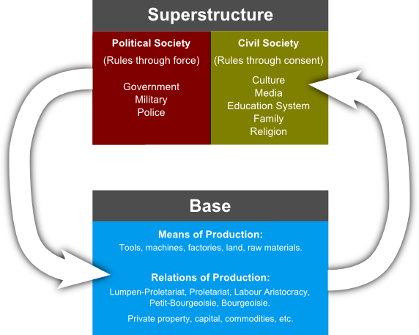

Slide 18
Change for Gramsci?
Discuss in class.
strengthening civil society?
strengthening democracy?

