Slide 1
Tata Laksana Perdarahan Uterus Disfungsional
Anastasia Setiani
1810211136

Slide 2
Perdarahan Uterus Disfungsional
Pendarahan Uterus Abnormal (PUA) adalah istilah yang digunakan untuk menggambarkan semua kelainan haid baik dalam hal jumlah maupun lamanya. Manifestasi klinisnya dapat berupa pendarahan dalam jumlah yang banyak atau sedikit, dan haid yang memanjang atau tidak beraturan (POGI).
Perdarahan Uterus Disfungsi (PUD) adalah perdarahan uterus abnormal yang terjadi tanpa adanya keadaan patologi pada panggul, penyakit sistemik tertentu, atau kehamilan (Sarwono).
Perdarahan uterus disfungsional (PUD) adalah bagian dari perdarahan uterus abnormal (PUA).

Slide 3
Tujuan Tata Laksana
Menghentikan perdarahan
Mengatur haid supaya normal kembali
Mengendalikan dan mencegah perdarahan berulang
Memperbaiki atau mengobati dan mengobati patologi yang ada

Slide 4
The goal in the treatment of DUB is to halt the acute bleeding episode and prevent recurrence. If the patient wishes to become pregnant, the secondary goal would be to restore ovulation. Timely and correct diagnosis is critical as improper diagnosis can lead to incorrect medical management, unnecessary surgery, and endometrial hyperplasia or carcinoma (up to 2% of women with inappropriately managed anovulatory bleeding eventually develop endometrial adenocarcinoma).
Arriving at a diagnosis may require several diagnostic tests that provide no definitive answers, and the NP needs to reassure the patient that every avenue is being explored to find the root of her medical condition. This reassurance cannot be understated, as a large component in the management of DUB is psychological and ample reassurance is a vital therapeutic tool.

Slide 5
If a hormone deficiency or systemic illness is detected in the patient's workup, then the appropriate treatment for that ailment would be administered. This may require collaboration with or referral to an endocrinologist or hematologist. If a prolactinoma is present that does not require surgery, treatment is oral bromocriptine 1.25 to 2.5 mg by mouth initially, increased gradually over 2 to 7 days until a therapeutic response is achieved. The drug is given in divided doses and should be taken with food to decrease gastrointestinal upset.

Slide 6
If neither of those apply, hormone therapy is the first-line treatment for DUB. Combination oral contraceptives (COCs) suppress endometrial development by reducing LH and FSH secretion and by reestablishing predictable bleeding patterns and resulting in a lighter flow. The NP should evaluate the patient for the benefits and risk associated with COC use. Patients taking COCs should be advised not to smoke because smoking increases the risk of adverse cardiovascular events especially in women over age 35. COCs are contraindicated in patients with arteriothromboembolic disease (myocardial infarction, stroke), history of or active deep vein thrombosis (DVT) or pulmonary embolus (PE), untreated hypertension, diabetes mellitus with vascular complications, breast cancer, estrogen-dependent neoplasia, undiagnosed abnormal genital bleeding, and active liver disease.¹

Slide 7
Conjugated estrogen (Premarin) alone can be administered in high doses in cases of hemorrhagic uterine bleeding. Severe cases may require inpatient treatment with I.V. estrogen.
This treatment is effective in rapid cessation of hemorrhage because it exerts a vasospastic action on capillary bleeding by affecting the level of fibrinogen, factor IV, and factor X in blood.
It also acts on platelet aggregation and capillary permeability. Estrogen induces formation of progesterone receptors, making subsequent treatment with progestins more effective. Estrogen therapy should only be used to control an acute bleeding situation as it does not treat the underlying cause.

Slide 8
Unopposed estrogen therapy also has risks, including DVT, PE, stroke, and endometrial hyperplasia/carcinoma. Progestin should be added immediately after the hemorrhage is controlled to prevent a later bleeding episode. If the COC is contraindicated, cyclic oral micronized progestin daily for 10 to 12 days per month promotes predictable uterine withdrawal bleeding. Although there are little data that suggest that progestin-only therapy is associated with increased risk of thrombotic events, caution should be exercised when considering its use.

Slide 9
For women unable to tolerate systemic hormones, the levonorgestrel-releasing intrauterine device (IUD) (Mirena) is an alternative; the drug received FDA-approval in 2009 for women with heavy menstrual bleeding who choose intrauterine contraception. This method controls the endometrium with low dose (20 mcg/day) local release of progestin.⁶ Studies report an 80% decrease in menstrual blood loss after 3 months and 90% decrease after 6 months of the insertion of this IUD. In 20% of study participants, menstrual bleeding had ceased altogether at 6 months.

Slide 10
In November 2009, the FDA approved tranexamic acid (Lysteda) as the first nonhormonal drug to treat heavy menstrual bleeding. It slows bleeding quickly (within 2 to 3 hours) because it helps stabilize and preserve the fibrin matrix by moderating plasmin activity. It is taken only a few days a month during menses, and is an option for patients who may wish to become pregnant in the near future. Tranexamic acid is contraindicated in women who have a history of or have active thromboembolic disease. Historically, androgen medications such as danocrine have been used to treat anovulatory bleeding; however, they have been known to cause irreversible masculinization of patients and are seldom used today.

Slide 11
Nonsteroidal anti-inflammatory drugs (NSAIDs) inhibit blood prostacyclin formation, and can effectively decrease uterine blood flow, and there is currently only one NSAID marketed that has this indication from the FDA. Although NSAIDs have been shown to treat menorrhagia in ovulatory cycles, they generally are not effective for the management of anovulatory DUB.

Slide 12
Another approach includes the short-term (up to 6 months) use of a GnRH agonist (leuprolide acetate). This medication suppresses gonadotropin, induces a medical castration, and breaks the ongoing cycle of abnormal bleeding in many anovulatory patients. Prolonged therapy with GnRH agonists, however, is associated with osteoporosis and other postmenopausal adverse reactions. Its use is often limited in duration and "add back" therapy with a form of low-dose estrogen and progestins hormonal replacement is given if therapy must extend beyond 6 months. Because of the expense of this drug, it is generally not a first-line approach, but can be used to achieve short-term relief from a bleeding problem or as preparation for surgical intervention.

Slide 13
MEDIKAMENTOSA

Slide 14
Medikamentosa
Hormonal
Non-hormonal
Progestin
Estrogen
Kontrasepsi oral
Danazol
GnRH analog
Nonsteroidal anti-inflammatory drugs (NSAID)
Asam Traneksamat

Slide 15
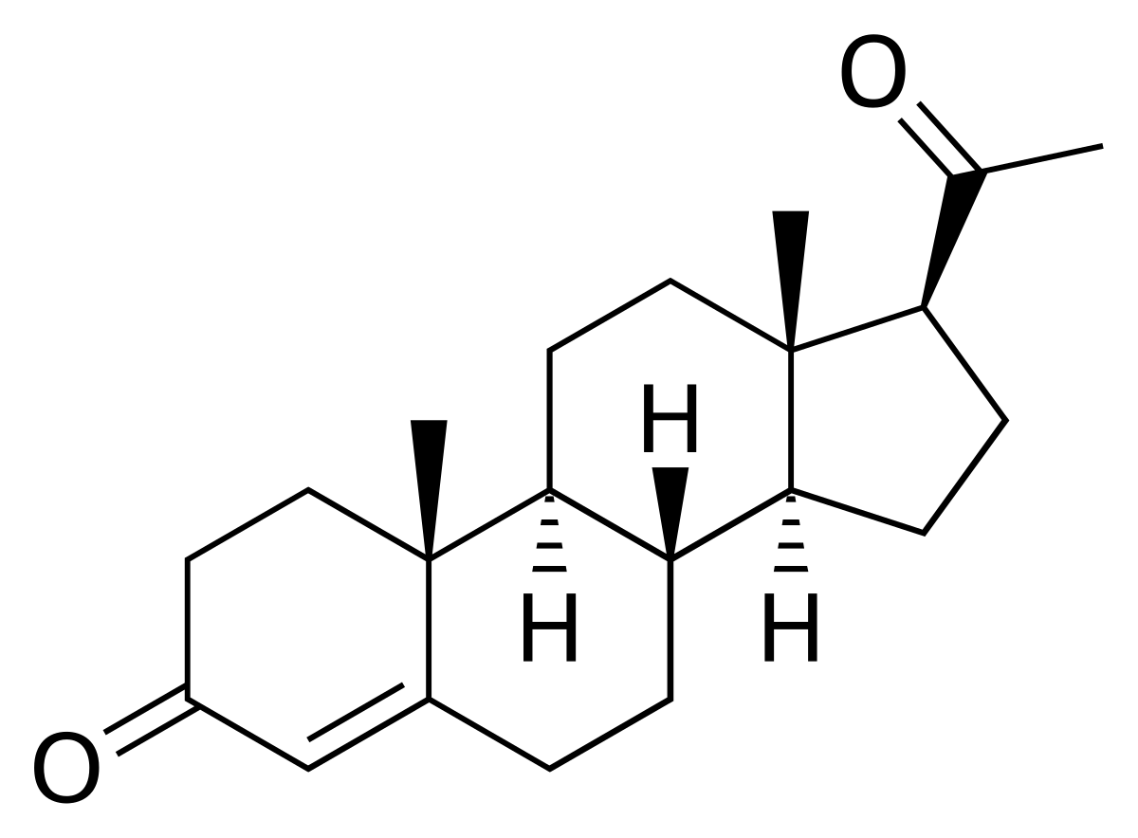
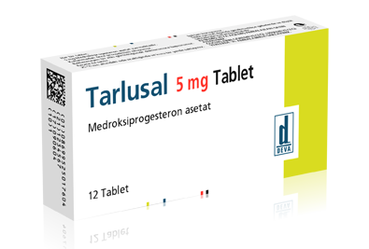
Terapi Hormonal
1. Progestin
MPA (Medroksi Progesteron Asetat) 2 x 10mg, Noretisteron asetat 2-3 x 5mg, Digosteron 2 x 10mg, Normegestrol asetat 2 x 5 mg diberikan selama 14 hari kemudian berhenti tanpa obat selama 14 hari dan diulang selama 3 bulan.
Cara kerja: menghambat reseptor estrogen dan menstimulasi aktivitas enzim 17β hidroksisteroid dehydrogenase dan sulfotransferase dalam endometrium → mengonversi estradiol menjadi estron yang kurang aktif → stabilisasi dinding endometrium dan peluruhan endometrium berkurang.

Slide 16
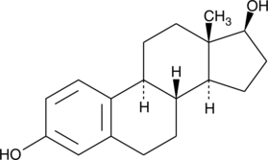
Terapi Hormonal
2. Estrogen
Estrogen konjugasi 1,25mg atau 17β estradiol setiap 6 jam selama 24 jam
Setelah perdarahan berhenti, lanjutkan dengan pemberian pil kontrasepsi kombinasi
Jika perdarahan tidak terkontrol dalam 12-24 jam → indikasi dilatasi & kuratase
Setelah perdarahan uterus berkepanjangan, lapisan epitel rongga uterus menjadi gundul → estrogen menginduksi kembali pertumbuhan endometrium menjadi normal dengan cepat.

Slide 17
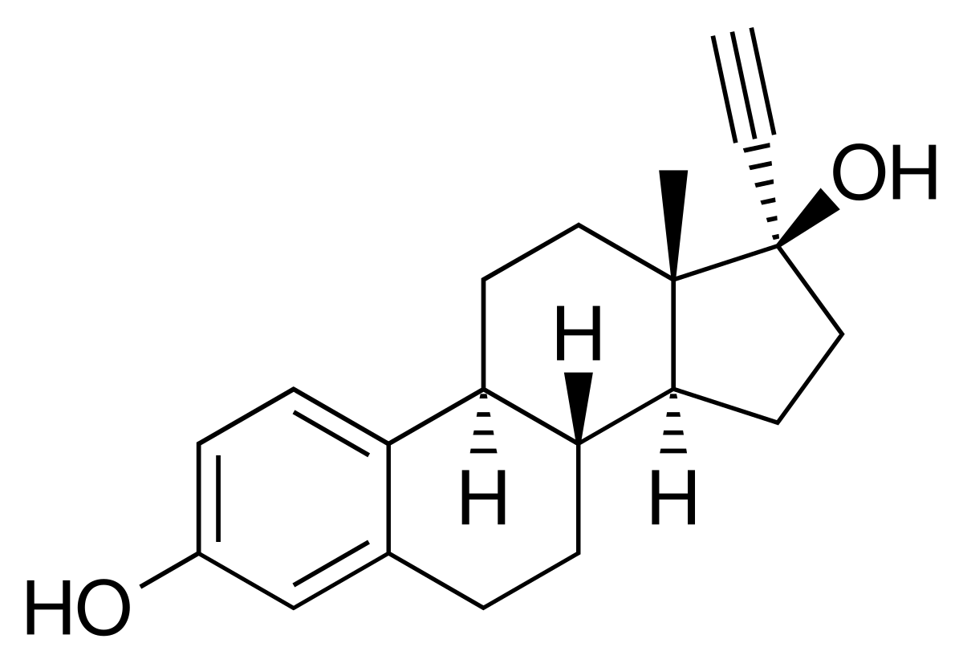
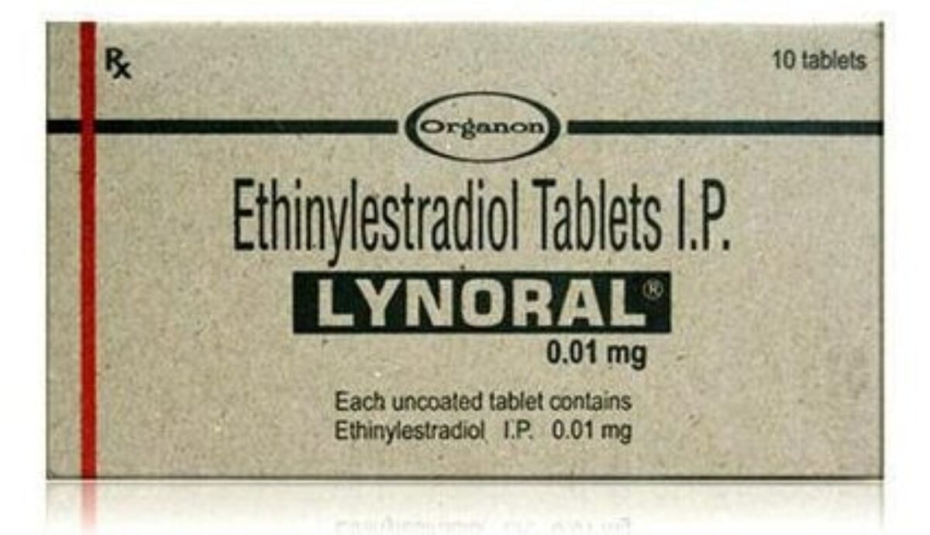
Terapi Hormonal
3. Kontrasepsi oral (kombinasi estrogen dan progestin)
- Etinil estradiol 20-50 mcg, rata-rata 30mcg
Dosis: 2x1 tablet selama 5-7 hari dan setelah terjadi withdrawal bleeding dilanjutkan 1 x 1 tablet selama 3-6 siklus. Dapat juga diberikan dengan dosis tapering off 4 x 1 tablet selama 4 hari → diturunkan jadi 3 x 1 tablet selama 3 hari → 2 x 1 tablet selama 2 hari → 1 x 1 tablet selama 3 minggu → berhenti tanpa obat selama 1 minggu → dilanjutkan pil kombinasi 1 x 1 tablet selama 3 siklus.
Menekan perkembangan endometrium, membangun kembali pola perdarahan yang dapat diprediksi, mengurangi aliran menstruasi, dan menurunkan risiko anemia defisiensi besi.

Slide 18
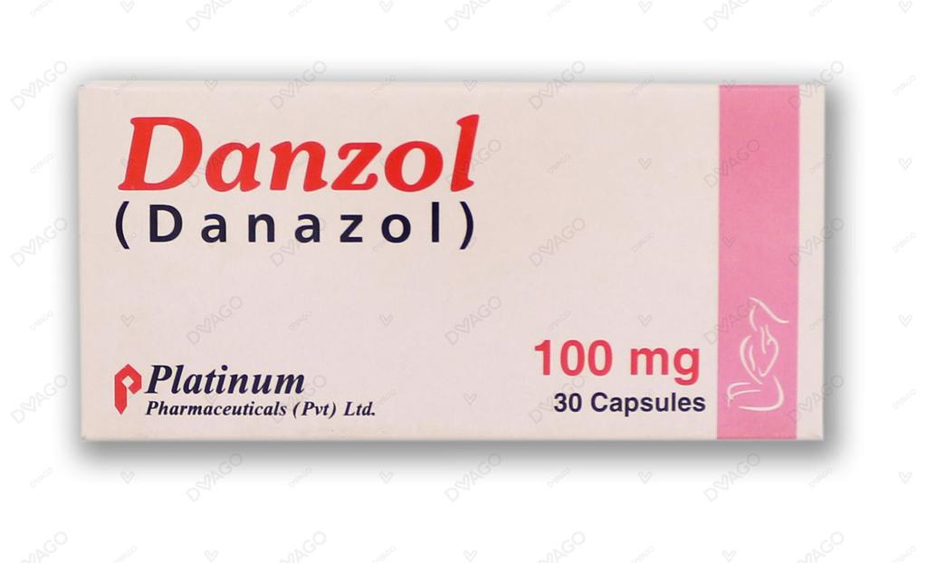
Terapi Hormonal
4. Danazol
Obat turunan testosterone. Dosis: 200mg/hari
Mengurangi aliran menstruasi dengan menginhibisi ovulasi, menurunkan kadar estrogen, dan menyebabkan atrofi endometrium.
Diketahui lebih efektif dibandingkan progestogen, kontrasepsi oral, dan NSAID tetapi dapat menyebabkan efek samping yang parah seperti jerawar, seboroik, BB naik, mual, lemah, iritabilitas, nyeri musculoskeletal, atrofi payudara, adenoma hepatic jinak jika pengobatan dalam jangka lama.
5. GnRH analog
Obat ini diberikan sebagai terapi sebelum dilakukan ablasi endometrium. Meningkatkan success rate operasi dan menurunkan risiko komplikasi.
Goserelin acetate (zoladex)

Slide 19
Terapi Non-Hormonal
NSAID
Asam Traneksamat
01
02
- Menurunkan sintesis PGE2 dengan menghambat enzim siklooksigenase → vasodilatasi pembuluh darah yang menyebabkan PUA
Asam mefenamat 250-500 mg, 2-4x/hari
Ibuprofen 600-1200 mg per hari
Sebagai antifibrinolitik → inhibitor kompetitif reversible aktivasi plasminogen → menghambat faktor yang terkait dengan pembekuan darah.
Dosis: 1 g (2 x 500 mg tablet) 3-4x/hari, diberikan pada awal pendarahan hingga 4 hari

Slide 20
NON-MEDIKAMENTOSA

Slide 21
Non-Medikamentosa
Konseling
Nutrisi tambahan
Terapi Bedah
Komunikasi
Informasi
Edukasi
terkait penyakit.
Tablet Fe di indikasikan untuk perbaikan anemia yang kemungkinan terjadi karena perdarahan.
Histerektomi
Ablasi endometrium

Slide 22
Histerektomi
Prosedur pengangkatan rahim (bisa melalui vaginal, sayatan pada perut (abdominal), atau laparoscopically assisted)
TIDAK untuk first-line theraphy, histerektomi dilakukan untuk perempuan yang sudah tidak masalah dengan tidak adanya uterus dan fertilitas.
Indikasi histerektomi:
Gagal atau menolak terapi hormonal
Memiliki anemia simptomatik
Mengalami gangguan dalam kualitas hidup karena perdarahan persisten irreguler
Angka keberhasilan : 100%. Kepuasan pasien : 95%
Komplikasi : infeksi, perdarahan, masalah penyembuhan luka

Slide 23
Jenis Histerektomi
Histerektomi Radikal
Pengangkatan seluruh rahim dan serviks, tuba fallopi, ovarium, bagian atas vagina, jaringan lemak dan kelenjar getah bening.
Prosedur ini dilakukan pada mereka yang mengidap kanker
Histerektomi Abdominal
Histerektomi Total
Pengangkatan seluruh bagian rahim termasuk mulut rahim (serviks) diangkat.
Histerektomi Subtotal
Pengangkatan bagian atas uterus dengan meninggalkan bagian segmen bawah rahim.
Tindakan ini umumnya dilakukan pada kasus gawat darurat obstetrik seperti pendarahan paska persalinan yang disebabkan atonia uteri, prolapsus uteri, dan plasenta akreta.

Slide 24
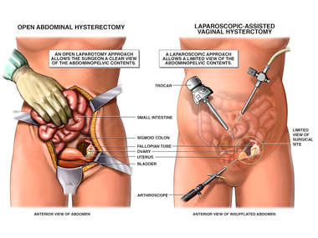
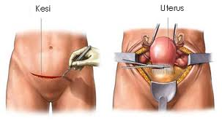
Histerektomi

Slide 25
Ablasi Endometrium
Prosedur bedah invasif minimal untuk mengurangi ketebalan endometrium (alternatif jika tidak mau histerektomi) tapi tidak efektif jika perdarahan karena adanya sel kanker.
Tidak disarankan pada wanita yang sedang hamil atau berencana hamil. Untuk kehamilan masih bisa tetapi jarang dan ada rentan terjadi komplikasi.
Jenis ablasi endometrium:
Cryoblation (pembekuan) 4. Microwave
Hidrotermal 5. Gelombang radio
Terapi balon panas
Komplikasi : keguguran, prematur, ruptur uterus, adhesi plasenta dalam kehamilan setelah prosedur ini.

Slide 26
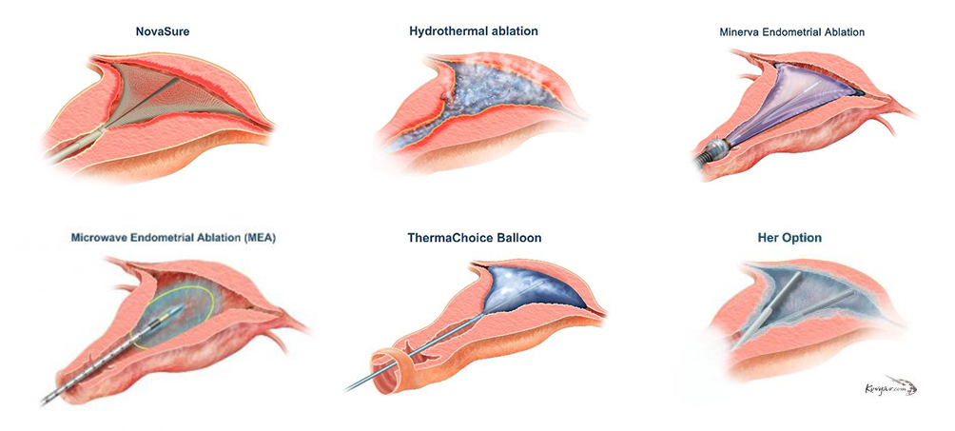
Ablasi Endometrium

Slide 27
Terima kasih
Referensi:
Alford WS & Hopkins MP. Endometrial rollerball ablation. Journal of Reproductive Medicine 1996;41(4):251-4.
Corbacioglu, Aytul. The Management of Dysfunctional Uterine Bleeding. Turkey. Bakirkoy Women’s and Children Teaching Hospital,
http://perpustakaan.poltekkes-malang.ac.id/assets/file/kti/1602420019/BAB_2.pdf (diakses 15/04/2021 pukul 2:10)
https://journals.lww.com/tnpj/fulltext/2011/08000/treatment_options_for_dysfunctional_uterine.7.aspx (diakses 15/04/2021 pukul 2:10)

