Slide 1
Indonesia dan Bantuan Luar Negeri
Indonesia dalam Ekonomi Politik Internasional
Afrimadona, Ph.D

Slide 2
Origins of foreign aid
American’s Marshall Plan to Europe from 1948-52 (transfer $ 13.6 billion in economic assistance and $ 7.8 billion in military assistance)
Foreign aids were rife during the Cold War when competition for sphere of influences between the two superpowers heightened.
During the Cold War, the US spent $ 400 billion foreign aids to its allies and other non-communist countries
Soviet Union also channeled foreign aids to allies like North Vietnam, Afghanistan, Ethiopia, Mongolia, Cuba and elsewhere.

Slide 3
Foreign aids were also spurred after decolonization. Aids were directed to countries which colonial countries want to maintain relations with.
Most governments give aid because:
It confers influence, offers strategic advantages, wins international prestige
It builds commercial contacts and opens the way for national companies that wish to invest in recipient states.
The ability to give aid is the mark of a successful economy, as Japan demonstrates

Slide 4
Three theories of foreign aid
Interest-driven theory
foreign aid is one of foreign policy intruments used to advance the interest of aid providers in the targetted countries.
Main consideration: Alliance, democracy, and strategic region
Humanitarian-driven theory
Foreign aid is the tool to alleviate humanitarian grievances in the recipient’s country
Main consideration: poverty, humanitarian crises
Domestic political theory
Variation in amount of aid is driven by the dynamics of domestic politics in the donor country
Main consideration: political power, ideology, and interests of domestic actors

Slide 5
Partisan theory of aid allocation

Slide 6
Foreign aid generally declined after the cold war
The end of ideological competition made foreign aid less important
Globalisation attenuated aid tied to colonial interests
Growing budget pressures squeezed donor resources
Disappointment with the effectiveness of aid weakened popular support
Unraveled coalition supporting aid in donor countries
Neoliberal challenges to intellectual foundations of aid

Slide 7
Indonesia and Foreign aid
During Soekarno era: foreign aid was sought from two competing blocs
  Soekarno’s non-aligned strategy along with Indonesia’s geopolitical importance was used to lure both sides
Aid has become a major supplement to the government’s income
Aid (loans) from Communist bloc were mostly used for industrial sector (Iron, steel chemical, and peaceful use of atomic energy), infrastructure and Asian Games complex
Aid (loans) from the US were mostly used for education, transportation, public health, agriculture and fisheries, and public administration

Slide 10
Aid and political groups
Political contestation between Soekarno vs the military (esp, the army)
Uneven distribution of aid: the benefits were based on socio-political hierarchy in the society
  The military
  Bureaucrats, business people, university lecturers, intellectuals, so on
  Urban workers
  Peasant
Large proportion of aid went to the military: foreign aid was used to help maintain political loyalty of those from who the government relied for its political survival

Slide 11
The use of foreign aid under Old Order
Maintain political power of the government (Soekarno’s administration)
Disbursed aid to the military to maintain their loyalty
Disburse aid to “the middle-class” and urban workers to alleviate their dissatisfaction with the regime
Aid, especially from Soviet and Communist bloc, was used to limit the PKI’s maneuverability
Close alliance with the communist bloc provide justification for the regime and prevent radicalization of the grass-root communists
At the same time, aid also increase PKI’s prestige and stature that revolt was seen as unnecessary
Aid from both sides can help reduce pressures from both sides on the government

Slide 12
Aid under New Order
Significant amount of aid from Western countries without conditionality → congenial relationship between Indonesia and the West
Indonesia dependent on aid for development
Constraint on government policy
Rent-seeking behavior increased due to lack of accountability
Financial crises deteriorated relationship with donor due to conditionality

Slide 13
Aid as Percentage of Development Exp, 1971-2004

Slide 14
Aid Flows as Percentage of GDP, 1971-2004

Slide 15
Aid as Percentage of Domestic Revenue, 1971-2004

Slide 16
Net official and private capital flows as % of GDP, 1970-2004

Slide 17
CA Deficit and Net Aid as % of GDP, 1970-2004

Slide 26
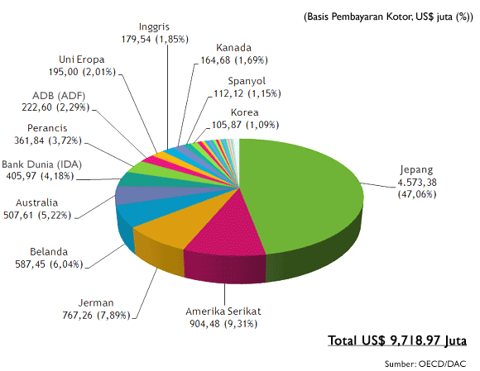
Bantuan LN terhadap Indonesia (2001-2005)

Slide 27
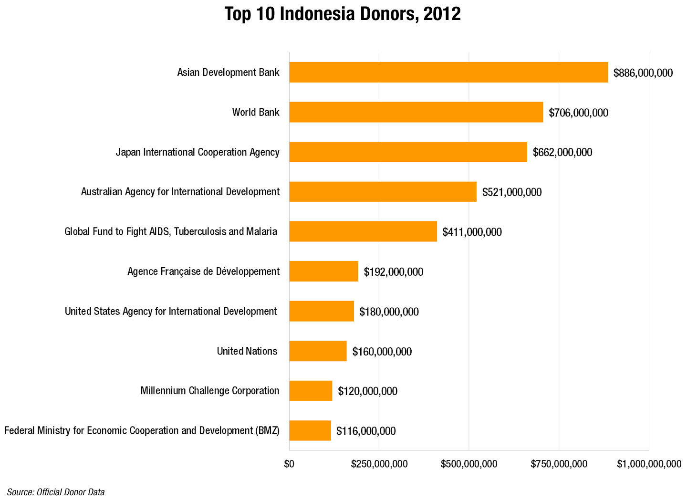

Slide 28
Foreign Loans Financing, 2001-2011
Notes:
*) State Budget (Revision) 2010

Slide 29
Foreign Loans by Creditor Types, 2000-2010
Multilateral donor (WB and ABD) and Japan has been acting in providing soft loan with long maturity and low cost
Notes:
*) as of Dec 31th, 2010

