Slide 1
Pelvic Inflammatory Disease
Muhammad Dhaffa
1810211056

Slide 2
Definisi
Pelvic inflammatory disease (PID) adalah kelainan infeksius dan inflamasi pada saluran genital atas wanita, termasuk uterus, tuba fallopi dan struktur pelvis yang berdekatan

Slide 3
Etiologi
Mikroorganisme: N. gonorrhea, C. trachomatis
Sexually transmitted disease

Slide 4
Epidemiologi
Tidak ada data spesifik internasional tentang insidensi PID dunia
Di Indonesia, insidensinya diekstrapolasikan sebesar lebih dari 850.000 kasus baru setiap tahun
PID merupakan infeksi serius yang paling biasa pada perempuan usia 16 – 25 tahun

Slide 5
Risk factors
Menstruating woman younger than 25 years who has multiple sex partners
Does not use contraception
Lives in an area with a high prevalence of STIs
Young age at first intercourse is also a risk factor for PID

Slide 6
Clinical Symptoms
Depends on the severity of infection, may be minimally symptomatic
Fever (≥ 38°C)
Nausea
Vomiting
Severe pelvic and abdominal pain
Lower abdominal pain
Pain from PID usually lasts less than 7 days
Abnormal vaginal discharge in 75% cases
Abnormal uterine bleeding presents in more than 1/3 of patients
Gonococcal PID is thought to have an abrupt onset with more toxic symptoms

Slide 7
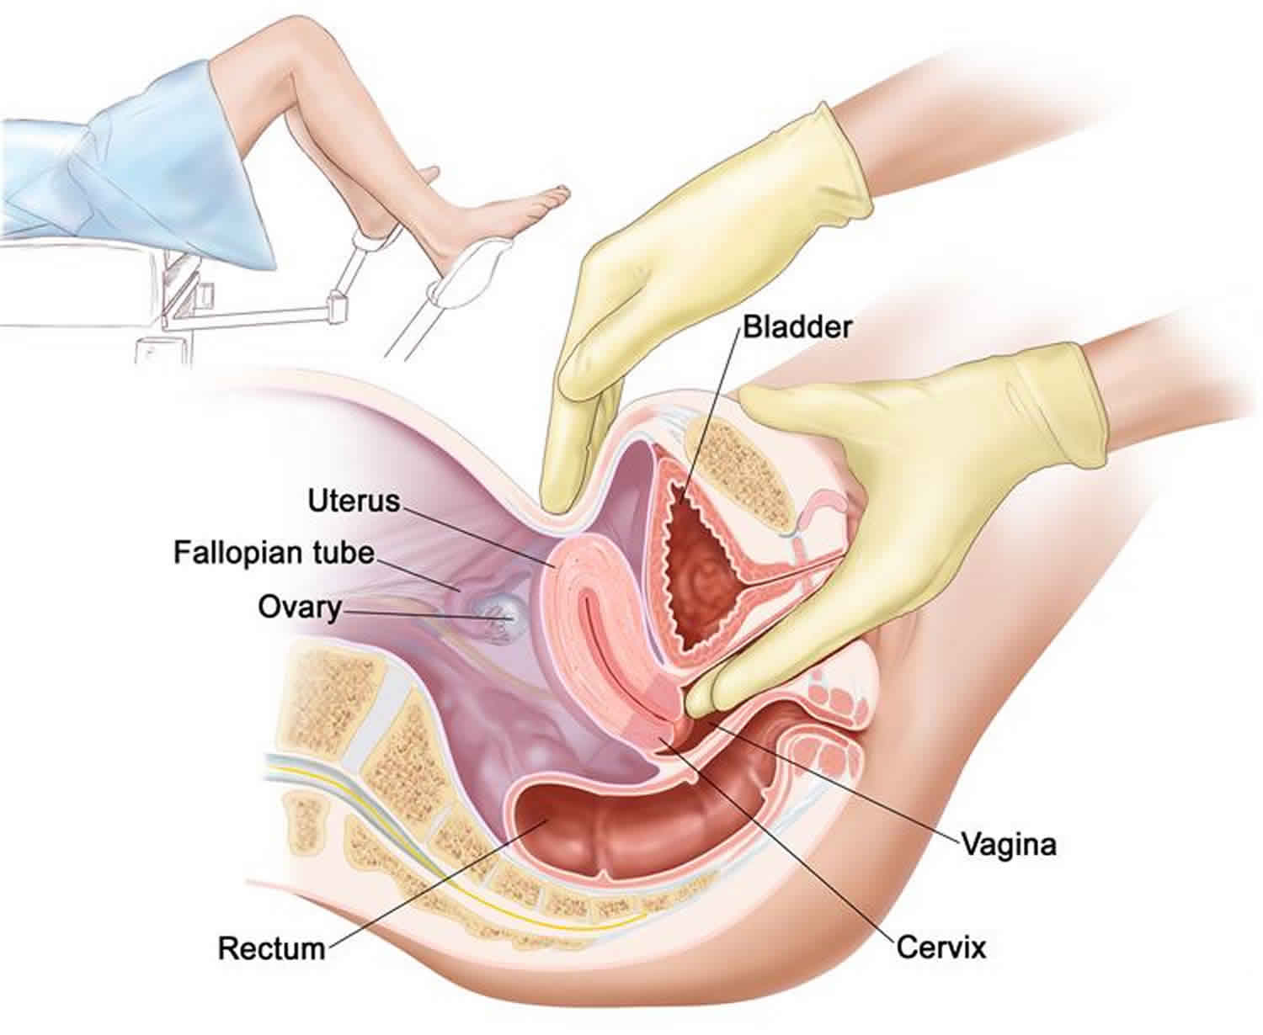
Physical Exams
Cervical motion tenderness (Chandlier sign)
Uterine tenderness
Adnexal tenderness
Vital sign: high temperature
Local sign: vaginal or cervical mucopurulent charge

Slide 8
Evaluation
Pregnancy test: to exclude the possibility of ectopic pregnancy
Microscopic test along with NAAT (nucleic acid amplification test)
Pelvic ultrasound: to exclude tubo-ovarian abscess

Slide 9
SPILF/CNGOF PID Guidelines
Positive diagnosis of pelvic inflammatory disease (PID) is based on adnexal pain or tenderness upon cervical motion, reinforced by associated signs, including fever, leukorrhea, and metrorrhagia
Lab studies: Hyperleukocytosis accompanied by a high C-reactive protein (CRP) level suggests complicated PID or an alternative diagnosis (eg, acute appendicitis)
Imaging studies: Pelvic ultrasonography is too insensitive and unspecific for diagnosis of uncomplicated PID, although ultrasonography is recommended to evaluate for signs of complicated PID (eg, polymorphic collection) or an alternate diagnosis. Initiation of antibiotic therapy should not be delayed awaiting ultrasonography
Microbial test:
Chlamydia trachomatis is the most common bacterial cause of PID, particularly in women younger than 30 years

Slide 10
Treatment
Indications for hospitalization include pregnancy, failed outpatient treatment, severe clinical illness, PID with pelvic abscess, or possible need for surgical intervention
Empiric treatment for PID in the inpatient setting includes:
Cefotetan (2 g IV / 12 hours) plus doxycycline (100 mg PO / 12 hours) or
Cefoxitin (2 g IV / 6 hours) plus doxycycline (100 mg PO / 12 hours) or
Clindamycin (900 mg IV / 8 hours) plus gentamicin (3 to 5 mg/kg IV once daily)
The CDC recommends the following for first-line treatment for outpatient therapy:
Doxycycline (100 mg orally twice a day for 2 weeks) plus ceftriaxone 250 mg intramuscularly (IM) for one dose or cefoxitin 2 g IM with probenecid (1 g orally) for one dose or another parenteral third-generation cephalosporin
Metronidazole (500 mg orally twice per day for 14 days) should be added if there is a concern for trichomonas or recent vaginal instrumentation

Slide 11
Follow-up
The PID recurrence rate is 15%-21%, of which 20%-34% cases are due to recurrent STI
NAAT of vaginal samples to evaluate for N gonorrhoeae, C trachomatis, and M genitalium should be performed 3-6 months after treatment of STI-associated PID to rule out reinfection. Condom use after STI-associated PID reduces the recurrence risk. Systematic oral contraceptives are not recommended after PID.
Prior to insertion of an intrauterine device, vaginal sampling for microbiological diagnosis is recommended.
Women with PID are at high risk of ectopic pregnancy.

Slide 12
Complications
PID has 3 principal complications, as follows:
Chronic pelvic pain
Infertility
Ectopic pregnancy

Slide 13
Referensi
Medscape
NCBI
Ilmu Kandungan Sarwono

