Slide 1
Embriologi Plasenta
Muhammad Wigrha
1610211118

Slide 3
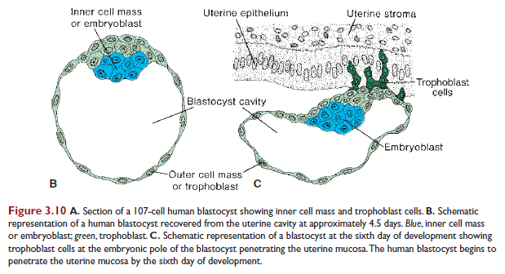

Slide 4
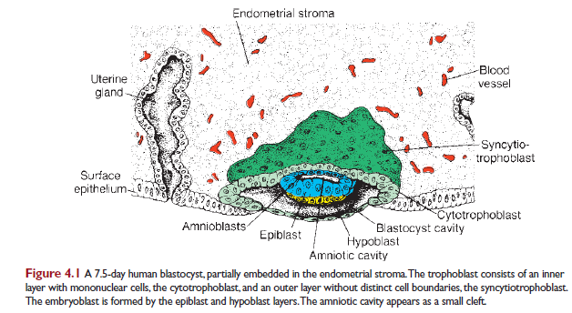
Day 8

Slide 5
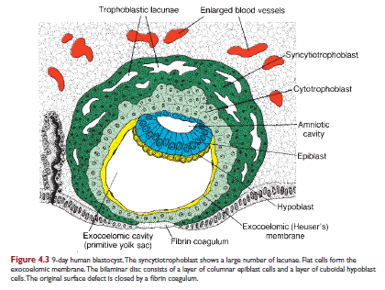
Day 9

Slide 6
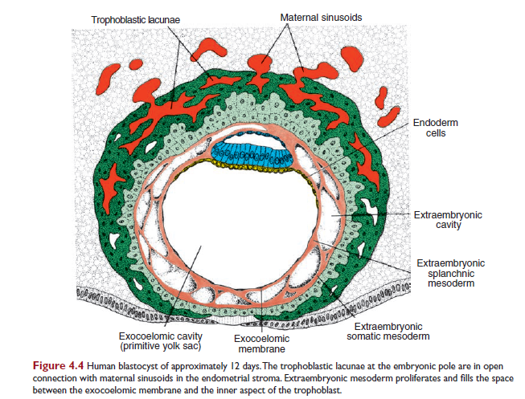
Day 12

Slide 7
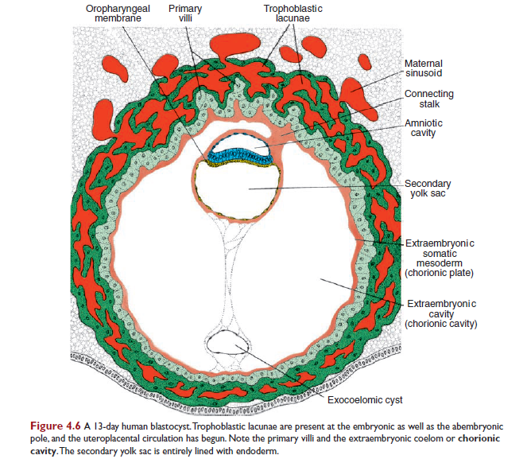
Day 13

Slide 8
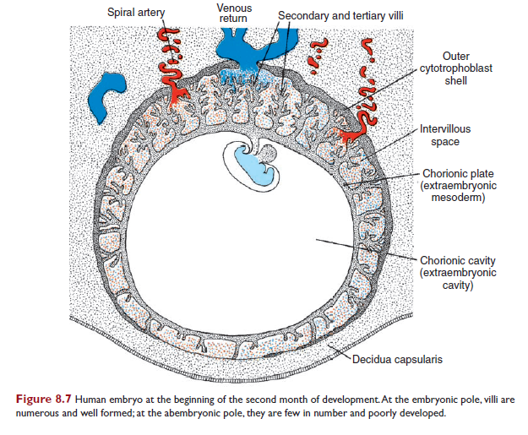
2nd month

Slide 9
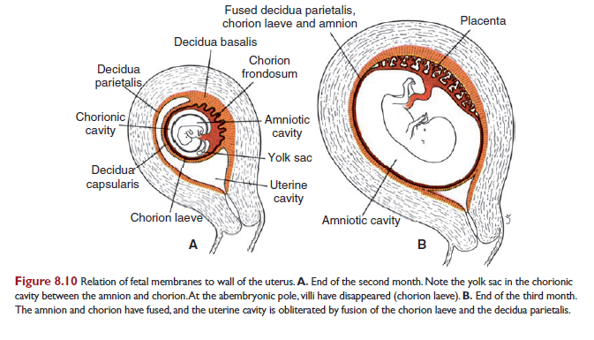
3nd month

